Slide 1

Programming One (csc7050)
Aidan McGowan
Compound assignment operators

Slide 2
Compound Assignment Operators
The compound assignment operators abbreviate assignment expressions.
variable = variable operator variable;
where operator is one of the binary operators +, -, *, / or %
Example | Using the addition compound assignment operator +=
c = c + 3; | c += 3;

Slide 3
Arithmetic compound assignment operators
initially num = 6 (for each example)
Operator | example | explanation | assigns
+= | num += 4; | num =num+4; | num to 10
-= | num -=2; | num=num-2; | num to 4
*= | num*=3; | num=num*3 | num to 18
/= | num/=2; | num=num/2; | num to 3
%= | num%=5; | num=num%5; | num to 1

Slide 4
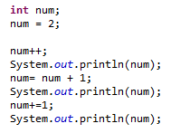
Increment (an alternative)
So using the increment operator ++ like this
    num++;
can be used instead of the expression
num = num + 1; or
  num += 1;
Same with the decrement operator

Slide 5
Increment and Decrement Operators
Java provides two unary operators for adding 1 to or subtracting 1 from the value of a numeric variable.
increment operator ++
decrement operator --
Commonly used in for loops

Slide 6
Pre and post fixed
prefix increment | postfix increment
++num | num++
Prefix causes variable to be incremented and then the new value of the variable is used in the expression it appears.
Postfix causes variable to be used in the expression it appears and then incremented.

Slide 7
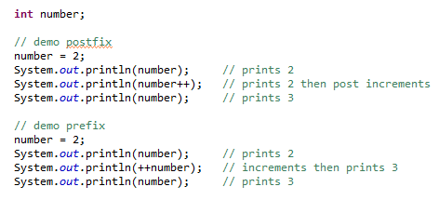
Post and prefixed

